Slide 1
Tree Data Structure

Slide 2
Tree Data Structure
We read the linear data structures like an array, linked list, stack and queue in which all the elements are arranged in a sequential manner. The different data structures are used for different kinds of data.
Some factors are considered for choosing the data structure:
What type of data needs to be stored?: It might be a possibility that a certain data structure can be the best fit for some kind of data.
Cost of operations: If we want to minimize the cost for the operations for the most frequently performed operations. For example, we have a simple list on which we have to perform the search operation; then, we can create an array in which elements are stored in sorted order to perform the binary search. The binary search works very fast for the simple list as it divides the search space into half.
Memory usage: Sometimes, we want a data structure that utilizes less memory.

Slide 3
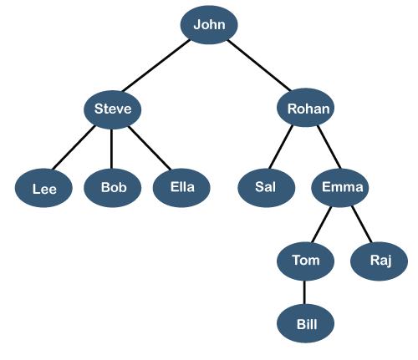
A tree is also one of the data structures that represent hierarchical data. Suppose we want to show the employees and their positions in the hierarchical form then it can be represented as shown below:

Slide 4
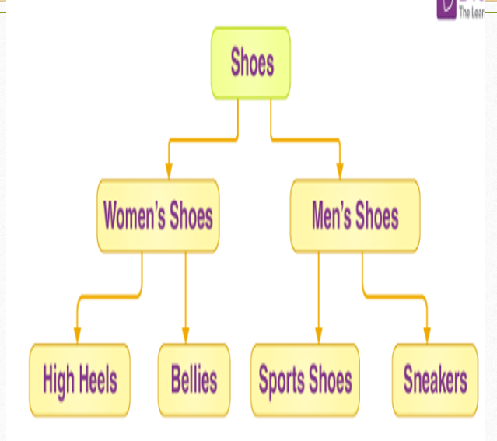

Slide 5
Let's understand some key points of the Tree data structure.
A tree data structure is defined as a collection of objects or entities known as nodes that are linked together to represent or simulate hierarchy.
A tree data structure is a non-linear data structure because it does not store in a sequential manner. It is a hierarchical structure as elements in a Tree are arranged in multiple levels.
In the Tree data structure, the topmost node is known as a root node. Each node contains some data, and data can be of any type. In the above tree structure, the node contains the name of the employee, so the type of data would be a string.
Each node contains some data and the link or reference of other nodes that can be called children.

Slide 6
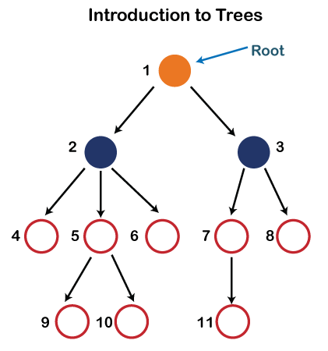
Some basic terms used in Tree data structure.
Let's consider the tree structure, which is shown below:

Slide 7
In the above structure, each node is labeled with some number. Each arrow shown in the above figure is known as a link between the two nodes.
Root: The root node is the topmost node in the tree hierarchy. In other words, the root node is the one that doesn't have any parent. In the above structure, node numbered 1 is the root node of the tree. If a node is directly linked to some other node, it would be called a parent-child relationship.
Child node: If the node is a descendant of any node, then the node is known as a child node.
Parent: If the node contains any sub-node, then that node is said to be the parent of that sub-node.
Sibling: The nodes that have the same parent are known as siblings.

Slide 8
Leaf Node:- The node of the tree, which doesn't have any child node, is called a leaf node. A leaf node is the bottom-most node of the tree. There can be any number of leaf nodes present in a general tree. Leaf nodes can also be called external nodes.
Internal nodes: A node has atleast one child node known as an internal
Ancestor node:- An ancestor of a node is any predecessor node on a path from the root to that node. The root node doesn't have any ancestors. In the tree shown in the above image, nodes 1, 2, and 5 are the ancestors of node 10.
Descendant: The immediate successor of the given node is known as a descendant of a node. In the above figure, 10 is the descendant of node 5.

Slide 9
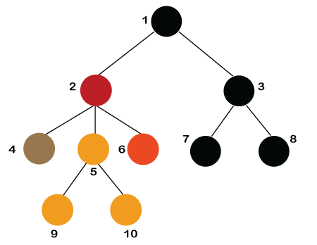

Slide 10
Number of edges: If there are n nodes, then there would n-1 edges. Each arrow in the structure represents the link or path. Each node, except the root node, will have atleast one incoming link known as an edge. There would be one link for the parent-child relationship.
Depth of node x: The depth of node x can be defined as the length of the path from the root to the node x. One edge contributes one-unit length in the path. So, the depth of node x can also be defined as the number of edges between the root node and the node x. The root node has 0 depth.
Height of node x: The height of node x can be defined as the longest path from the node x to the leaf node.
Note: Based on the properties of the Tree data structure, trees are classified into various categories.

Slide 11
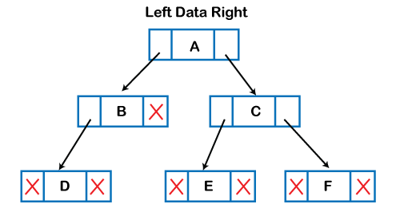
Implementation of Tree
The tree data structure can be created by creating the nodes dynamically with the help of the pointers. The tree in the memory can be represented as shown below:

Slide 12
The above figure shows the representation of the tree data structure in the memory. In the above structure, the node contains three fields. The second field stores the data; the first field stores the address of the left child, and the third field stores the address of the right child.
In programming, the structure of a node can be defined as:
struct node
{
int data;
struct node *left;
struct node *right;
}

Slide 13
The above structure can only be defined for the binary trees because the binary tree can have atmost two children, and generic trees can have more than two children. The structure of the node for generic trees would be different as compared to the binary tree.
Types of Tree:
Binary Tree
Binary Search Tree
AVL Tree
B-Tree

Slide 14
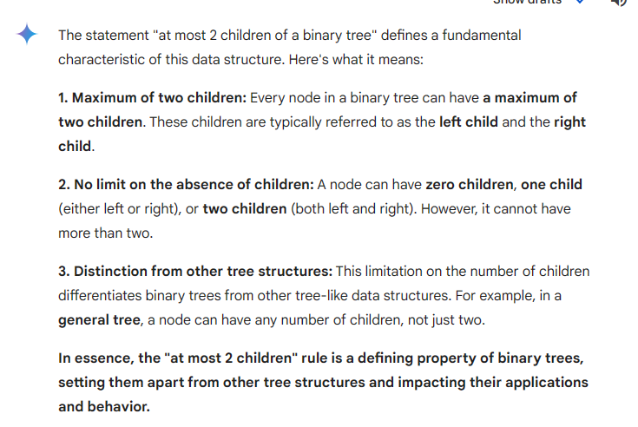
BINARY TREE PROPERTIES

Slide 15
Applications of trees
The following are the applications of trees:
Storing naturally hierarchical data: Trees are used to store the data in the hierarchical structure. For example, the file system. The file system stored on the disc drive, the file and folder are in the form of the naturally hierarchical data and stored in the form of trees.
Organize data: It is used to organize data for efficient insertion, deletion and searching. For example, a binary tree has a logN time for searching an element.
Trie: It is a special kind of tree that is used to store the dictionary. It is a fast and efficient way for dynamic spell checking.
Heap: It is also a tree data structure implemented using arrays. It is used to implement priority queues.
B-Tree and B+Tree: B-Tree and B+Tree are the tree data structures used to implement indexing in databases.
Routing table: The tree data structure is also used to store the data in routing tables in the routers.

Slide 16
Types of Tree
Binary Tree
Binary Search Tree
AVL Tree
B-Tree

Slide 17
Thanks

